Slide 1
Becoming a Red Team Operator
Presented By: Dylan Hudson
15 February 2025
CactusCon 2025

Slide 2
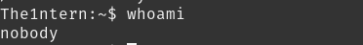





Board games
Video games

Slide 3

What am I doing here?
Penetration Test vs Red Team
Overview of terminology
Introduction to MITRE
Understanding tools
Keeping things fair
VECTR

Slide 4
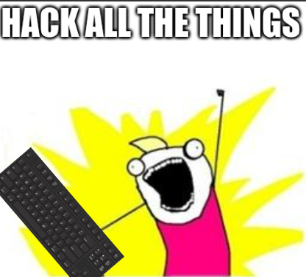
Penetration Test
Identification of vulnerabilities.
Minimal consideration of OPSEC.
Find everything you possibly can.

Slide 5

Red Team Operation
OPSEC considerations
Objective based
Systemic issues
Source: https://training.zeropointsecurity.co.uk/courses/red-team-ops

Slide 6
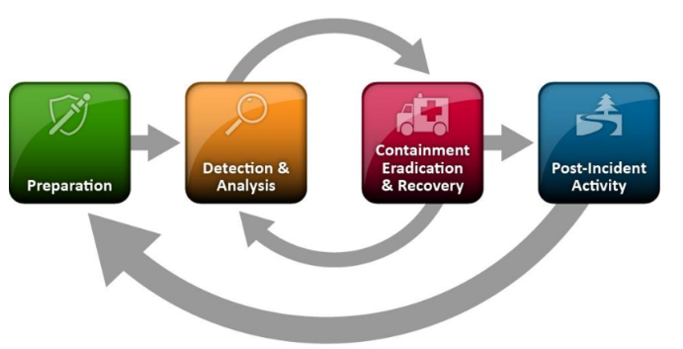
Blue Team
Source: NIST Computer Security Incident Handling Guide, figure from page 21

Slide 7
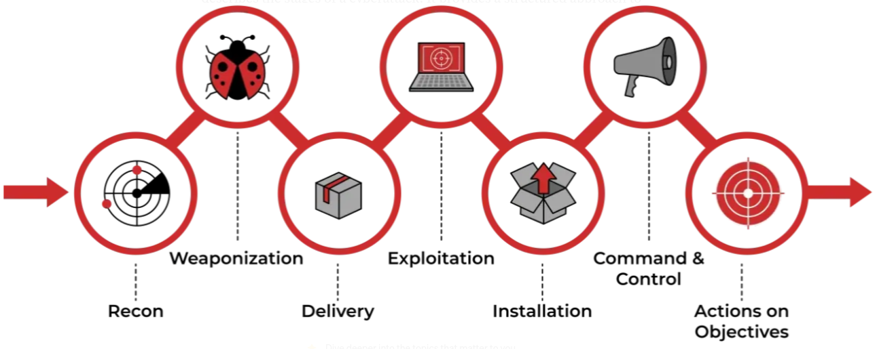
Red Team

Slide 8

Control Group
Sign off
Halt escalation
Constant contact

Slide 9


Slide 10
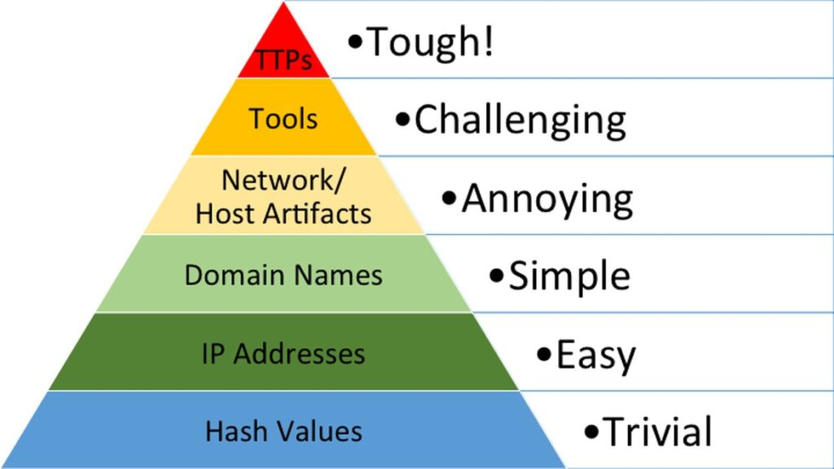
The Pyramid of Pain
Source: https://www.attackiq.com/glossary/pyramid-of-pain/

Slide 11

OPSEC
Secure your stuff!
Documentation
What does the tool do?
ISO8601
YYYY-MM-DDTHH:MM:SS-UTC

Slide 12
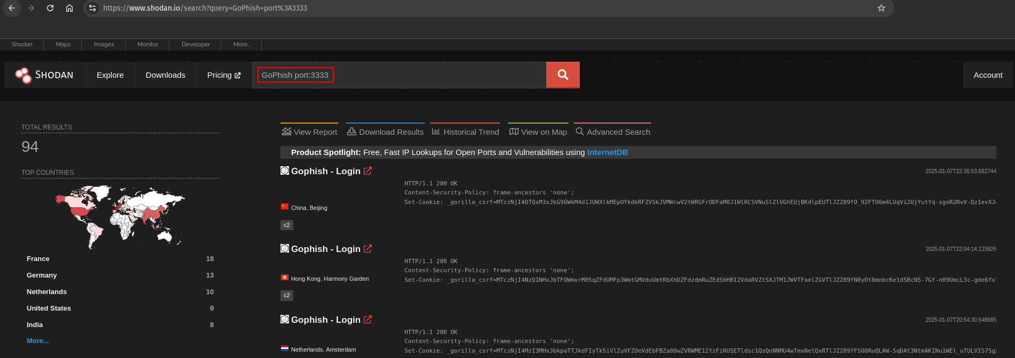

Slide 13
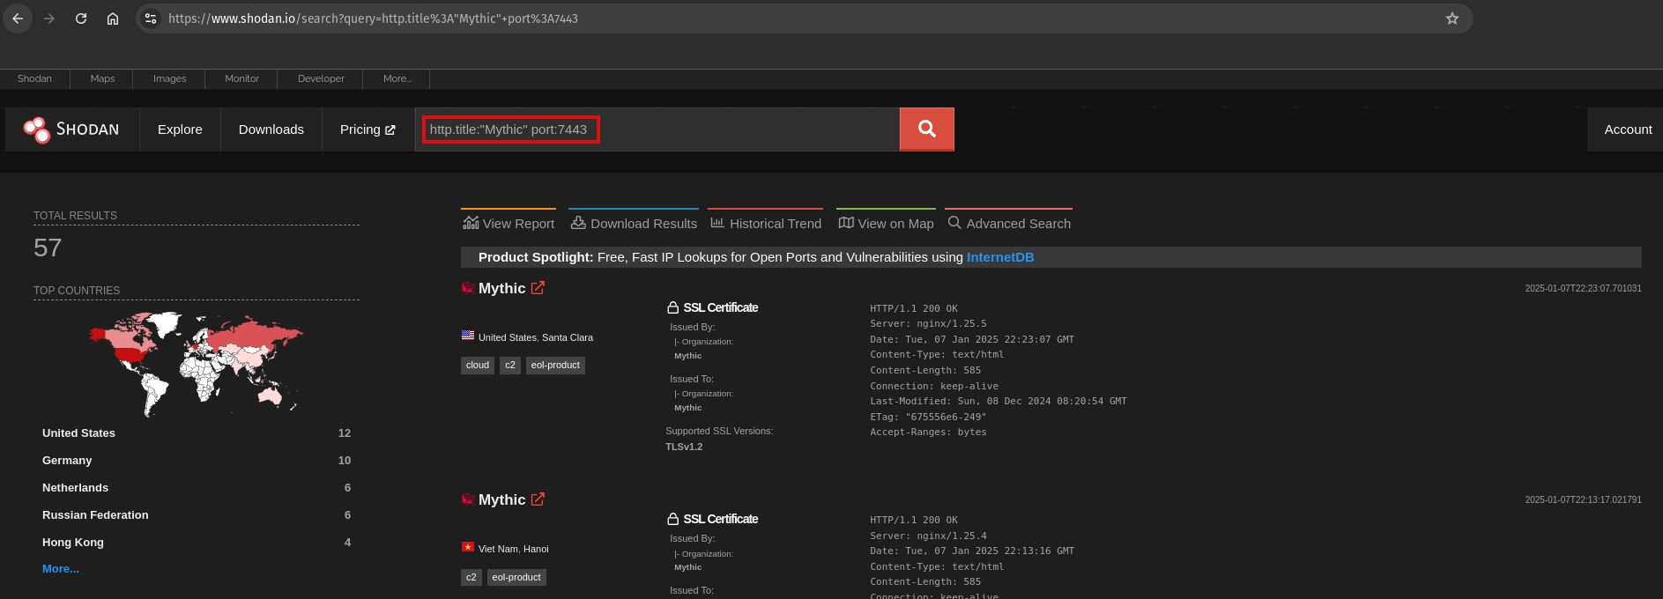

Slide 14

GoPhish
Easy to setup
User friendly
Contains identifiers

Slide 15
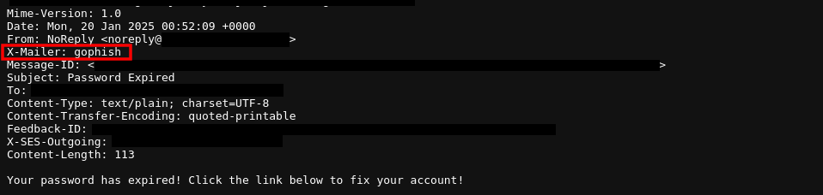
GoPhish Email Headers

Slide 16
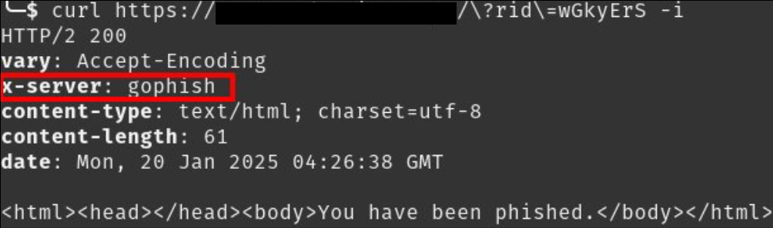
GoPhish Server Headers

Slide 17
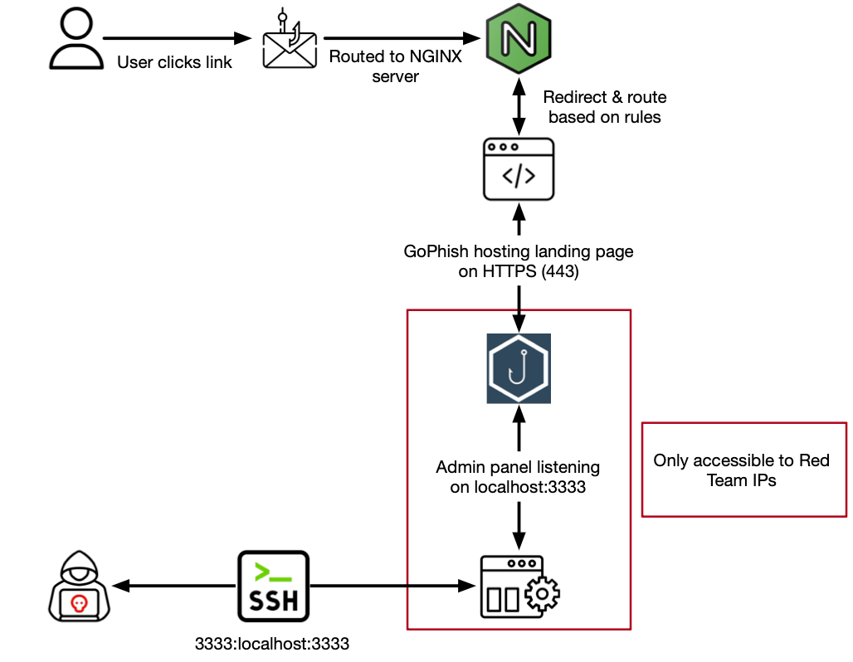

Slide 18
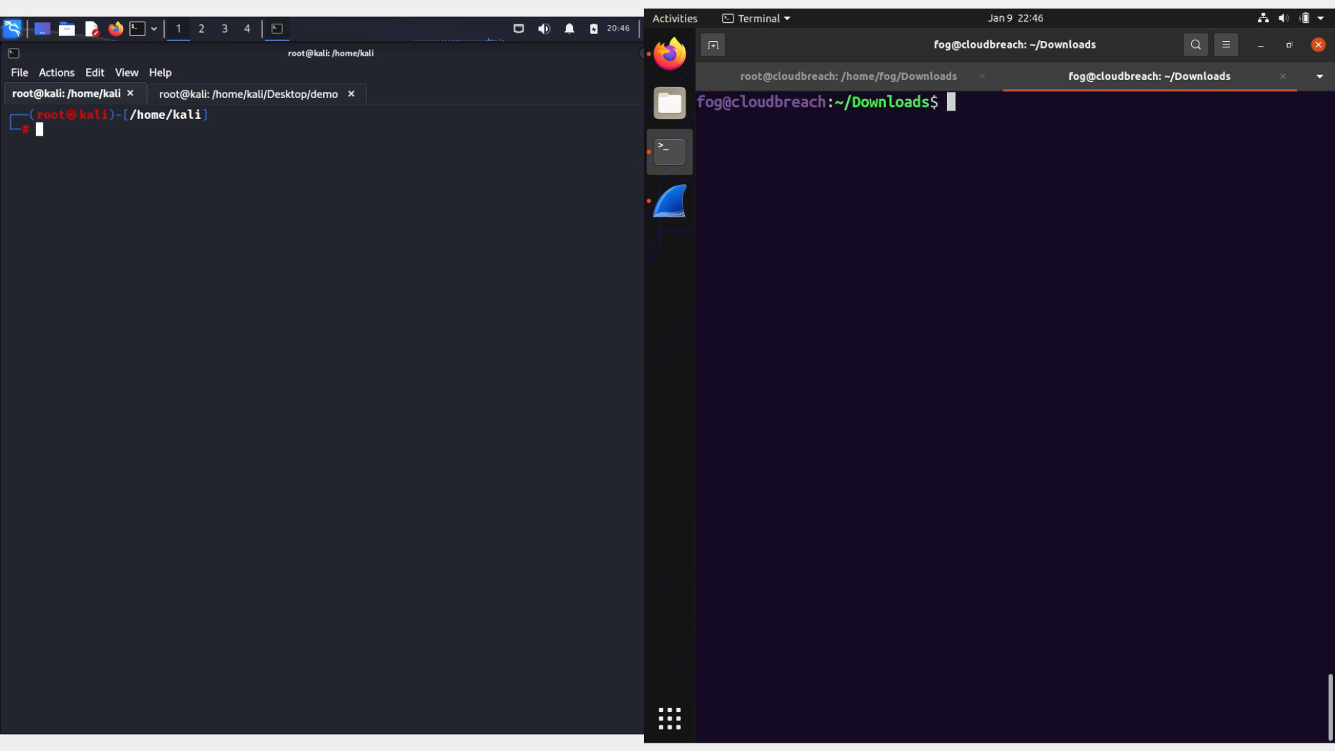

Slide 19
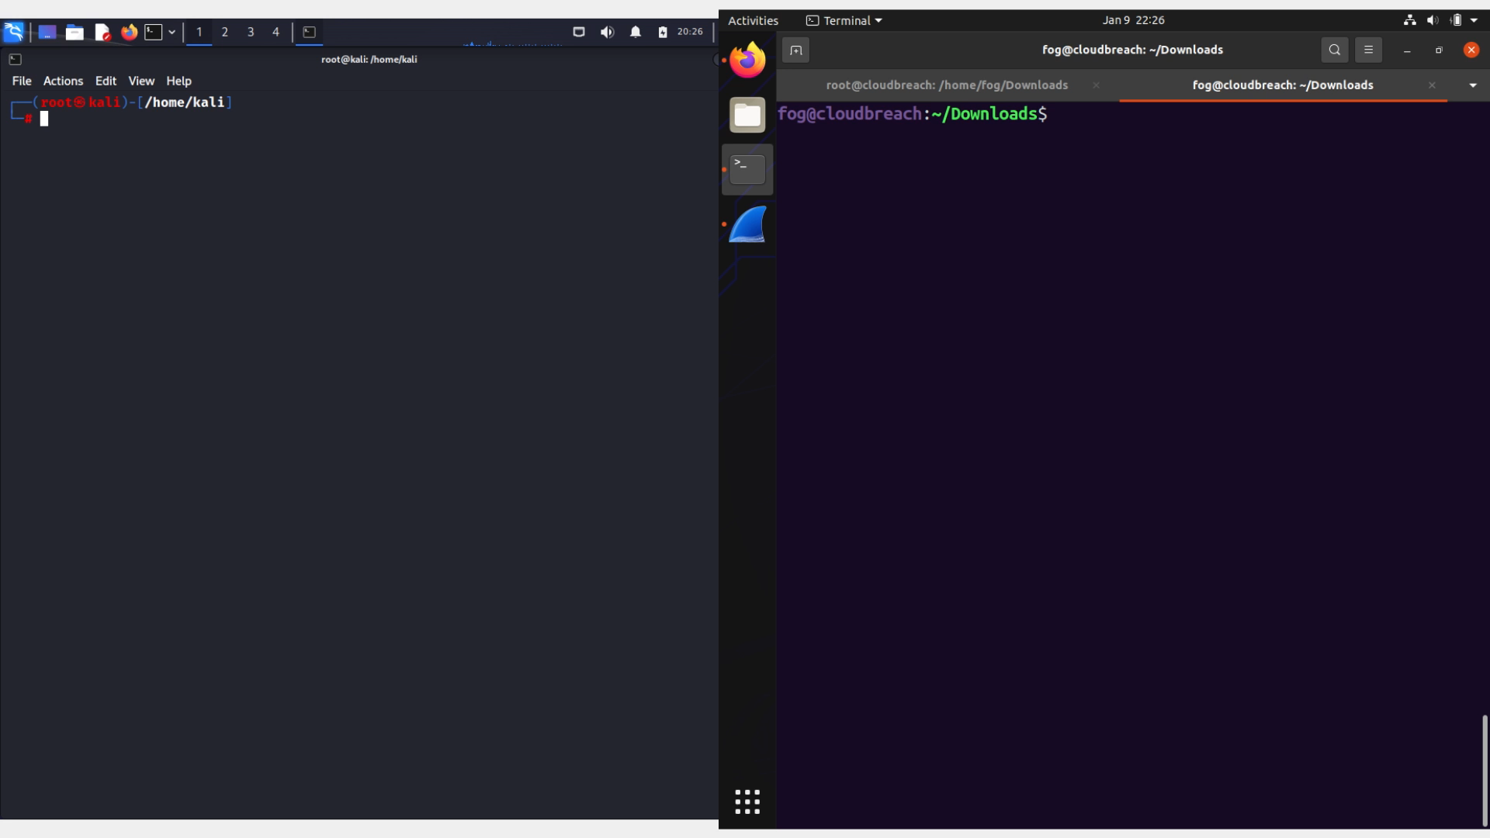

Slide 20
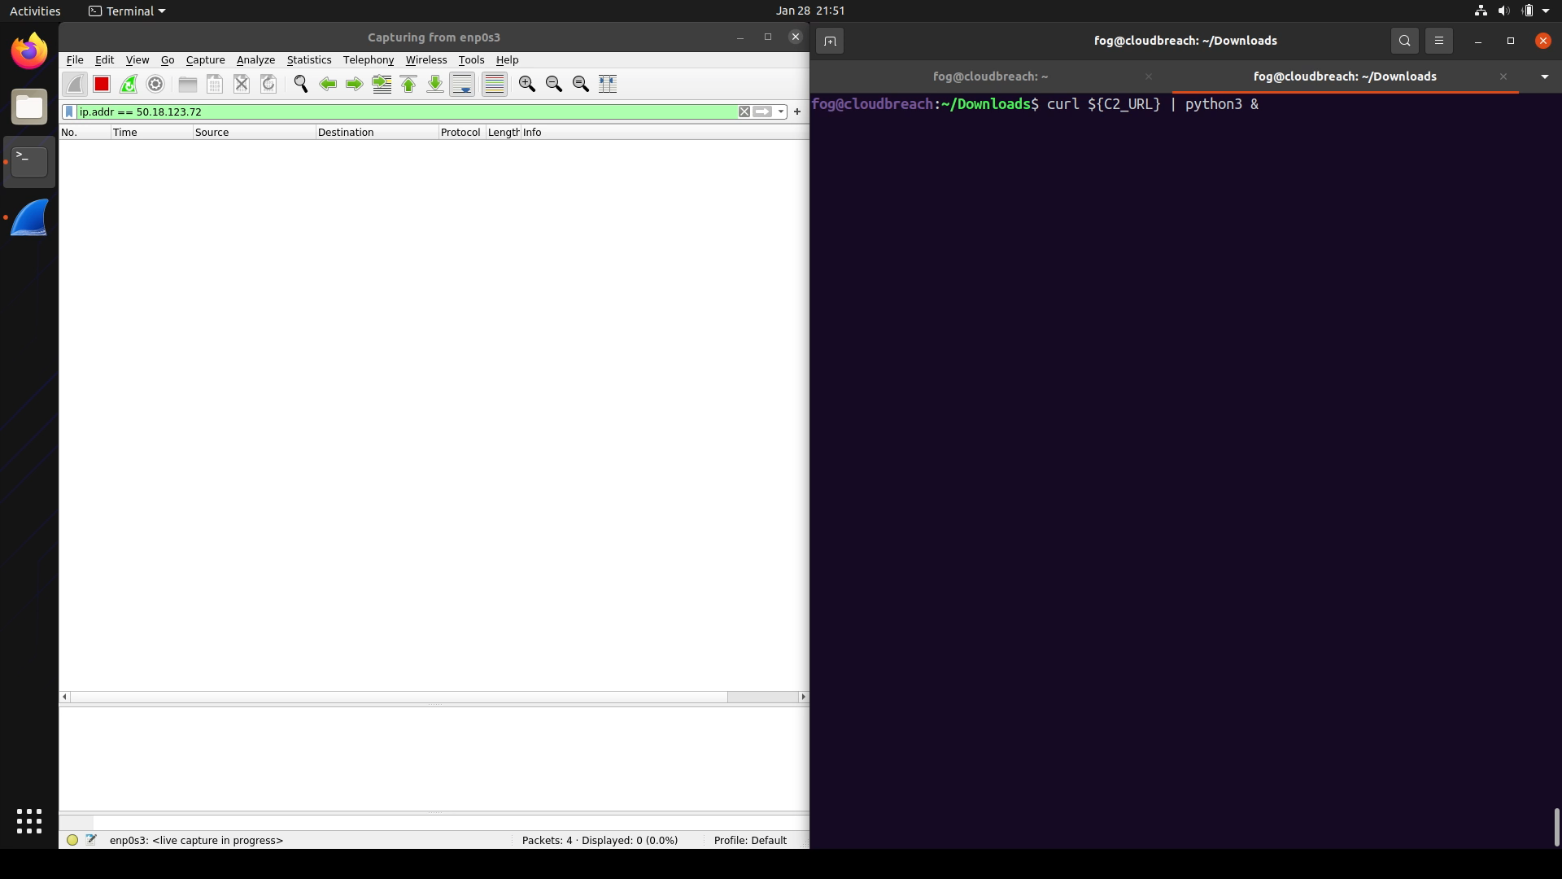

Slide 21
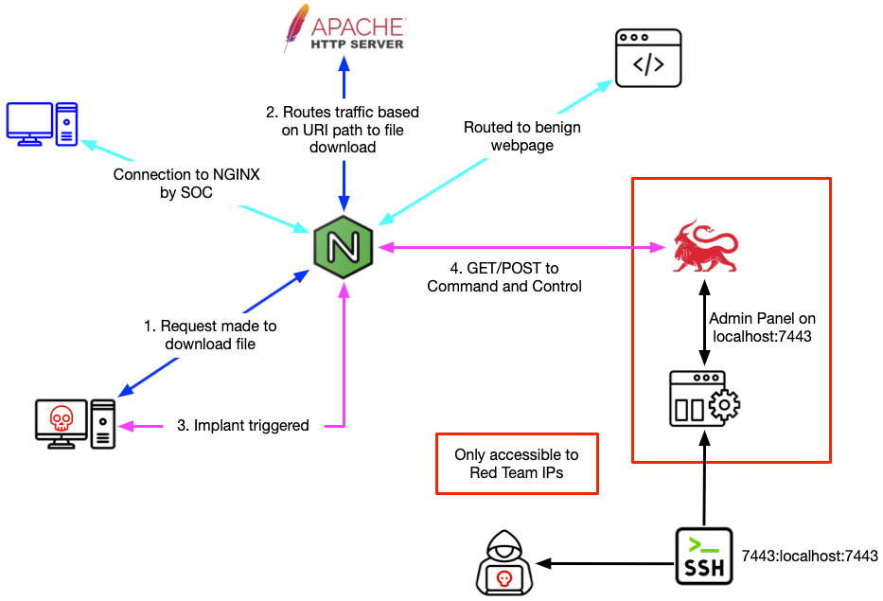

Slide 22
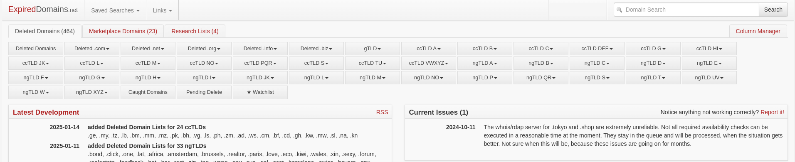

Slide 23

Trufflehog
Scanning repository technologies
Several regex based detectors
Consistent updates/fixes
Inx

Slide 24
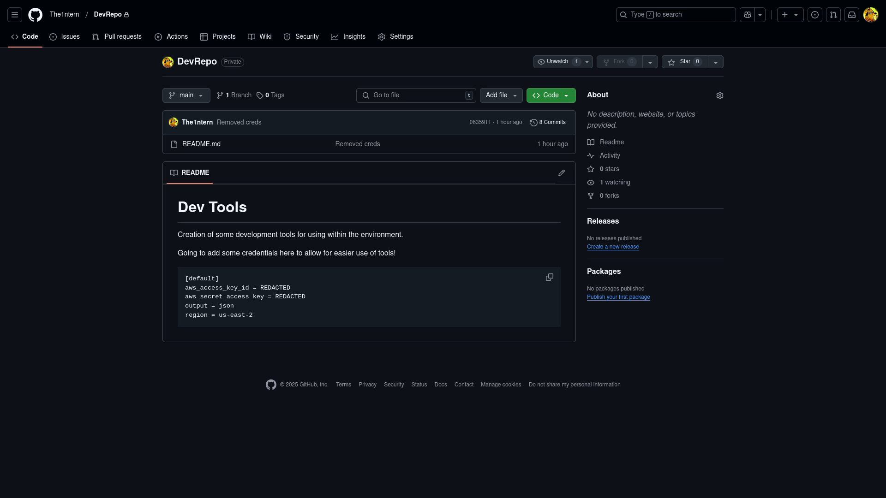

Slide 25

Pacu
Enumerating/storing information from AWS
Analysis of IAM data
Hides activity
Inx

Slide 26

Collecting Metrics

Slide 27
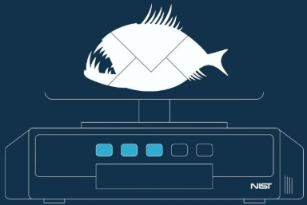
NIST Phish Scale
Standardized method of grading
Promotes "fairness" and transparency

Slide 28
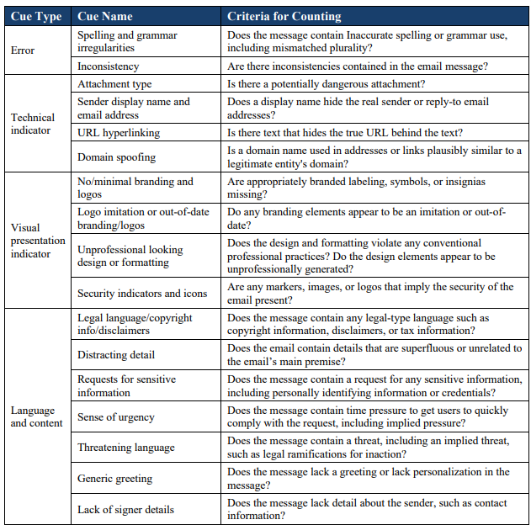
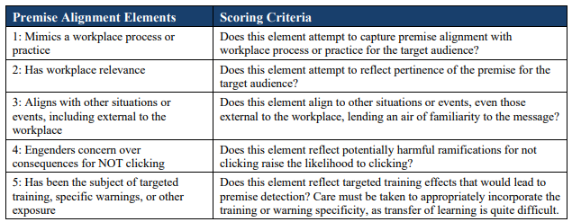
How a "Grading" is Determined

Slide 29
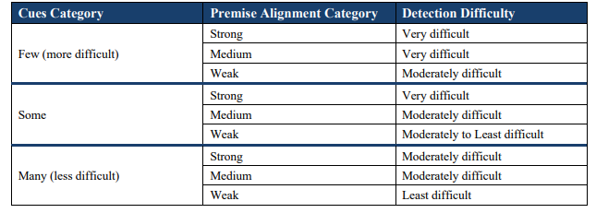
Determining the Final Difficulty

Slide 30

VECTR from Security Risk Advisors

Slide 31

Key Concepts
Customer kudos
Conduct internal surveys
Tooling consequences
Practice!
Continuous learning

Slide 32

Q&A / Resources
https://github.com/khast3x/Redcloud
https://github.com/bluscreenofjeff/Red-Team-Infrastructure-Wiki
https://www.ired.team/
https://github.com/A-poc/RedTeam-Tools
https://github.com/geeksniper/Red-team-toolkit
https://github.com/RedTeamOperations/Red-Infra-Craft/tree/main
https://github.com/SecurityRiskAdvisors/VECTR
https://mitre-attack.github.io/attack-navigator/
https://github.com/GhostManager/Ghostwriter
https://howto.thec2matrix.com/

